Slide 1


2020 Fall Product Program Training
Girl Scouts of Michigan Shore to Shore

Slide 2








Thank You!
We appreciate your time, energy and efforts
Our Product Program is a success because of YOU!
You help girls learn and develop skills that last a lifetime
We are excited to kick off this new Girl Scout year with you and look forward to “bravely sharing our strengths”

Slide 3
The Why for Girls
What Do Girl Scouts Learn from Fall Product Program?
What Have Girl Scouts Experienced Using the Money Earned from Fall Product Program?
How Have Troops Used Money Earned from Product Programs to Give Back?

Slide 4

What’s Your Why?
Why are you here today?
Why do you volunteer for this program?
Do you know WHY your time, efforts and energy matter?
Do you know the impact you are making on the lives of girls?

Slide 5
Bravely Be YOU!
You are directly impacting the future of girls by…
Facilitating the largest girl-led entrepreneurial program in the world
Assisting girls in earning funds to support their amazing girl-led adventures and service opportunities locally, nationally and globally
Providing girls the opportunity to share their skills to make the world a better place
You are providing girls with life-changing experiences by trusting your strengths

Slide 6

Your efforts matter
Use your strengths to create memorable experiences for girls
Stay focused on the why
Be a resource for your troops and girls
Set goals for your service unit and encourage troops to do the same as an example to girls
Deliver products and rewards
Share the value and benefits of the program

Slide 7
Three toed pygmy sloth
Found living on Isla Escudo de Veraguas off the coast of Panama
It is the smallest of the three toed sloths and was only recognized as a species in 2001
Habitat destruction is the largest threat to the species
Sloths can swim
A unique species of green algae is found on the fur and is considered symbiotic, providing camouflage without detriment to their health
Population <100
Size around 6 pounds
Eats primarily leaves of red mangroves

Slide 8
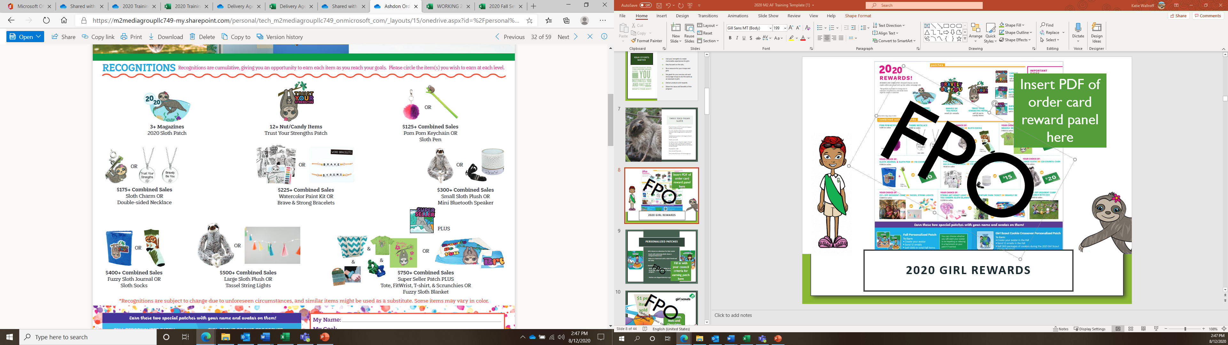
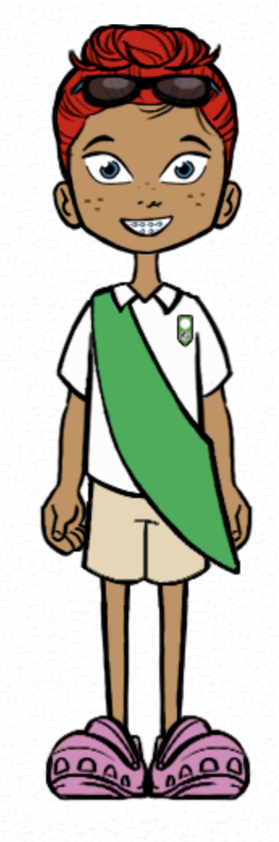
2020 Girl Rewards

Slide 9
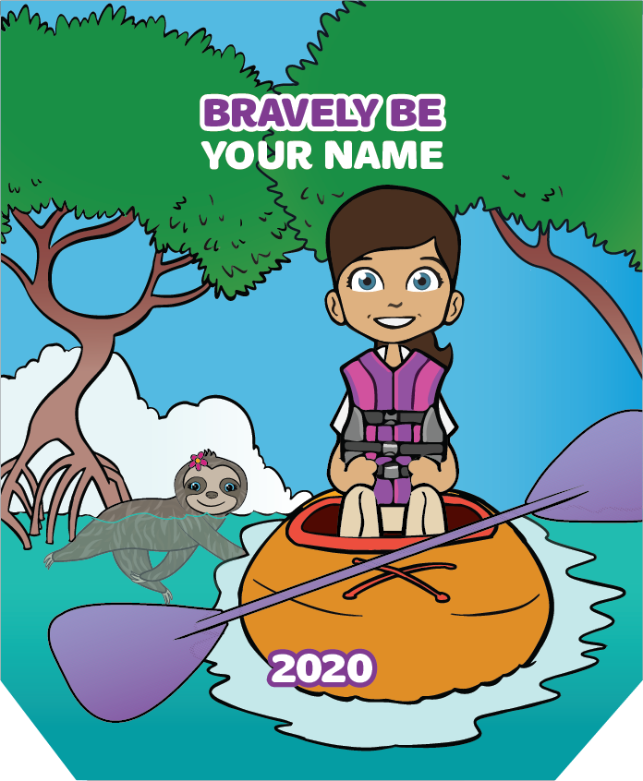
Personalized Patches
Girls choose an adventure for their avatar
Kayak with swimming sloths down a mangrove-lined river
Relax on a hammock with a sloth friend and her baby
Earned by:
Sending 15+ Emails & $250 in total Fall sales
Patches are shipped directly to girls

Slide 10


Earn 10% of total sales
+2% with reward opt out
*Cadettes, Seniors, Ambassadors
Troop proceeds

Slide 11
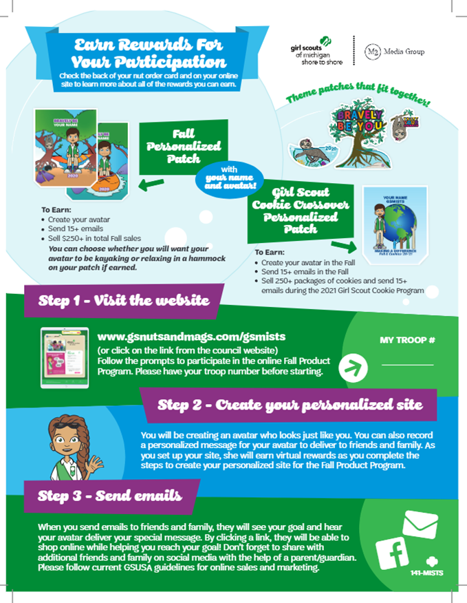

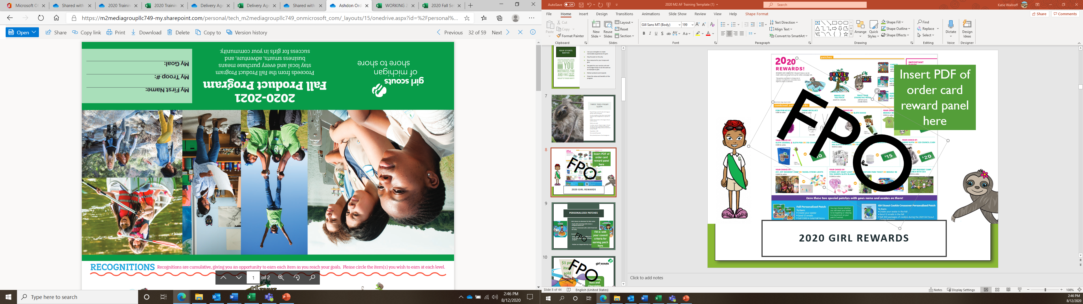
Two Ways to Participate
Girls offer a variety of items to family and friends in two ways
  In-person using a nut order card
  Online sending emails and sharing link on social media to purchase magazines and nuts/chocolates

Slide 12


Nut, Chocolate and candy Products

Slide 13
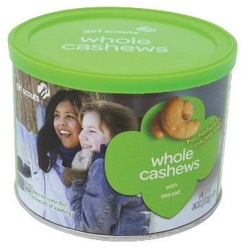



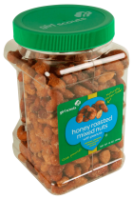

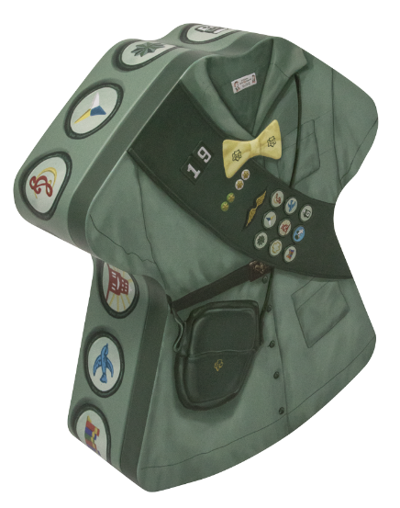
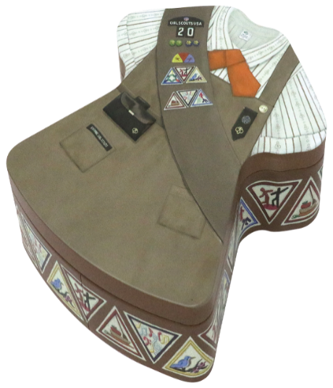
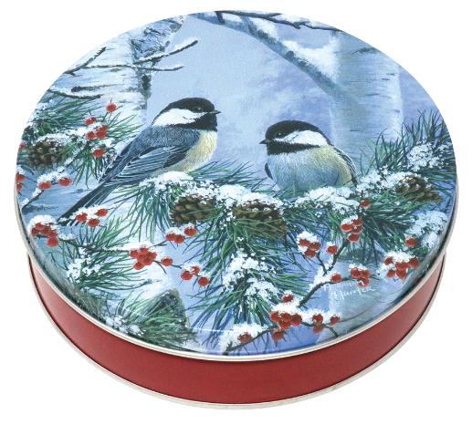
Nuts
Snack Mixes
Chocolates
Gift Items

Slide 14


Fall 2020 Order Card
NUTS & CANDY
Troop Proceeds
10% per unit
OR
12% per unit if selecting without rewards

Slide 15
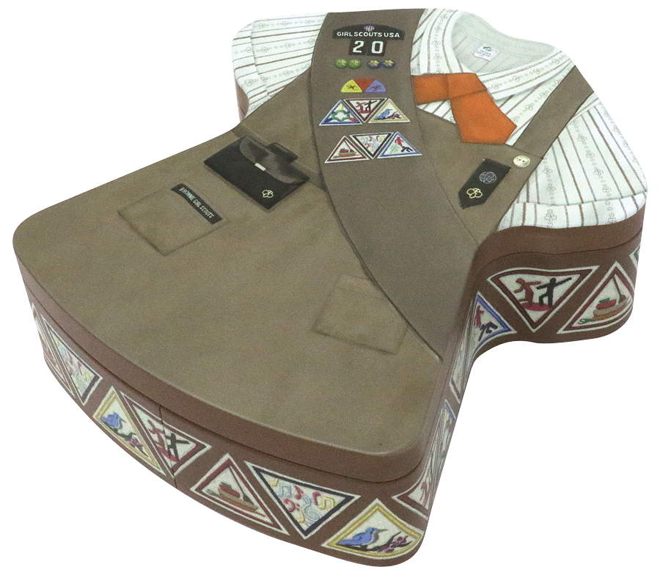
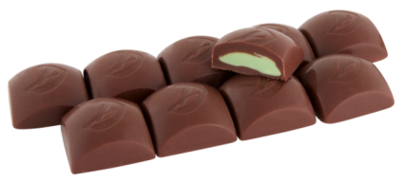

Mint Treasures
Mint Treasures
individually wrapped
with Girl Scout logo
GS Brownie Uniform Tin - $9

Slide 16
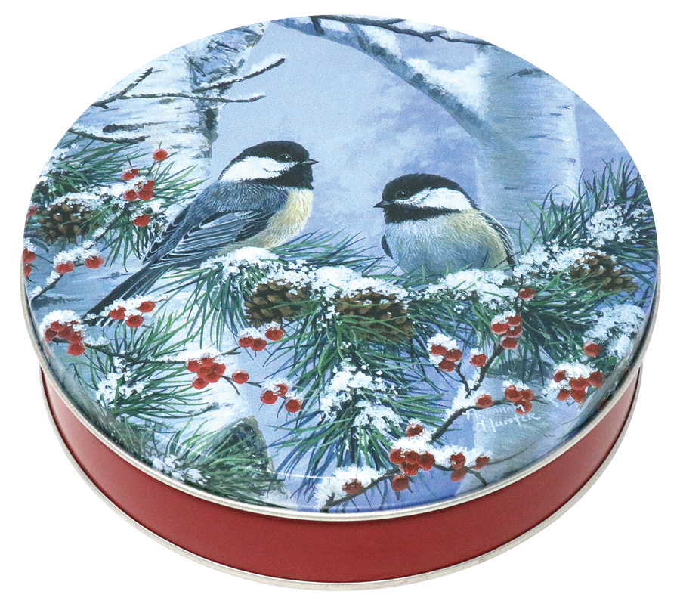

Caramel Treasures
$8 Chickadee Tin

Slide 17
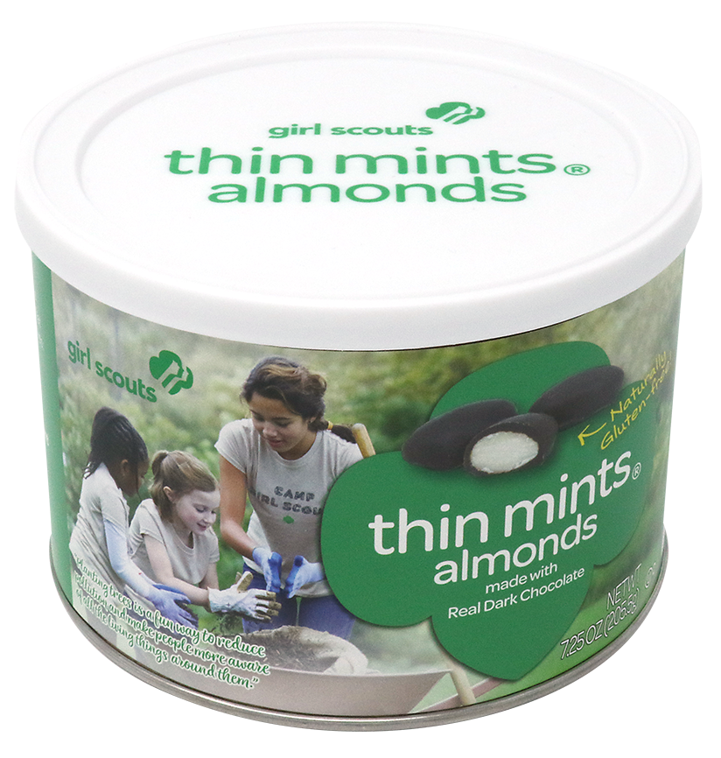
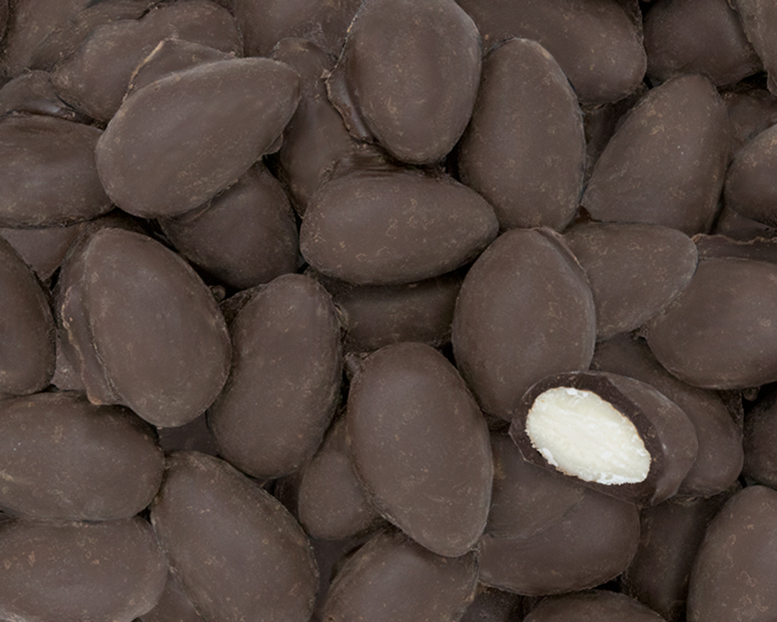
Thin Mints Almonds
$8 Pop-top Can

Slide 18
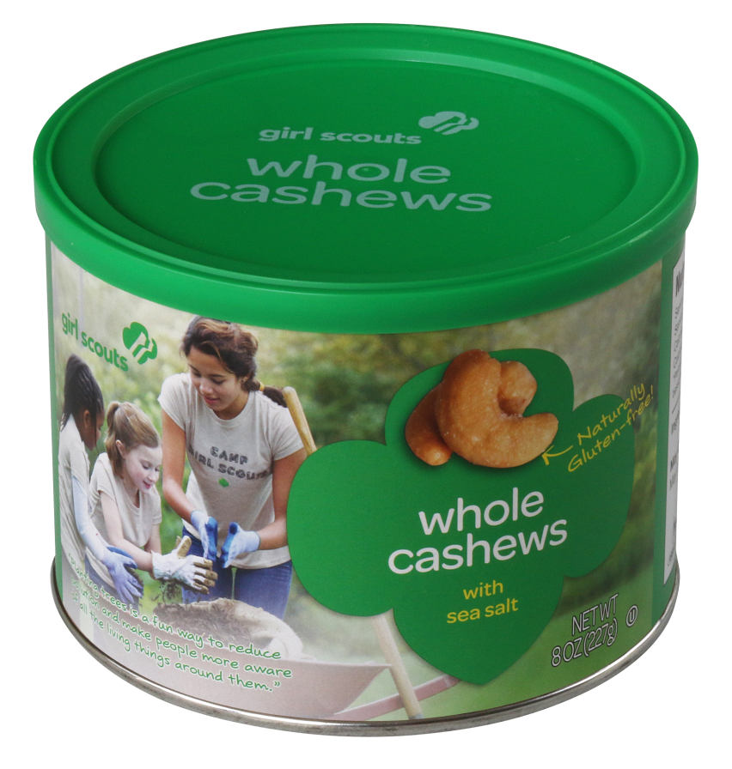
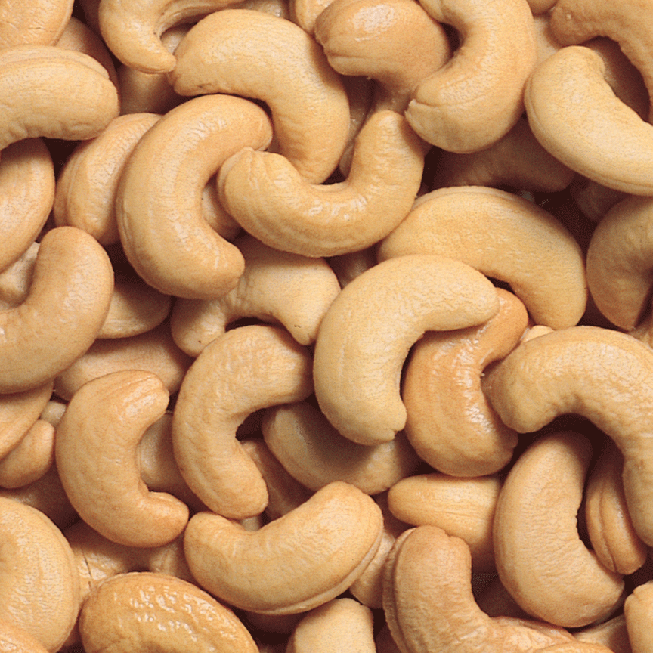
Whole Cashews
$8 Pop-top Can

Slide 19
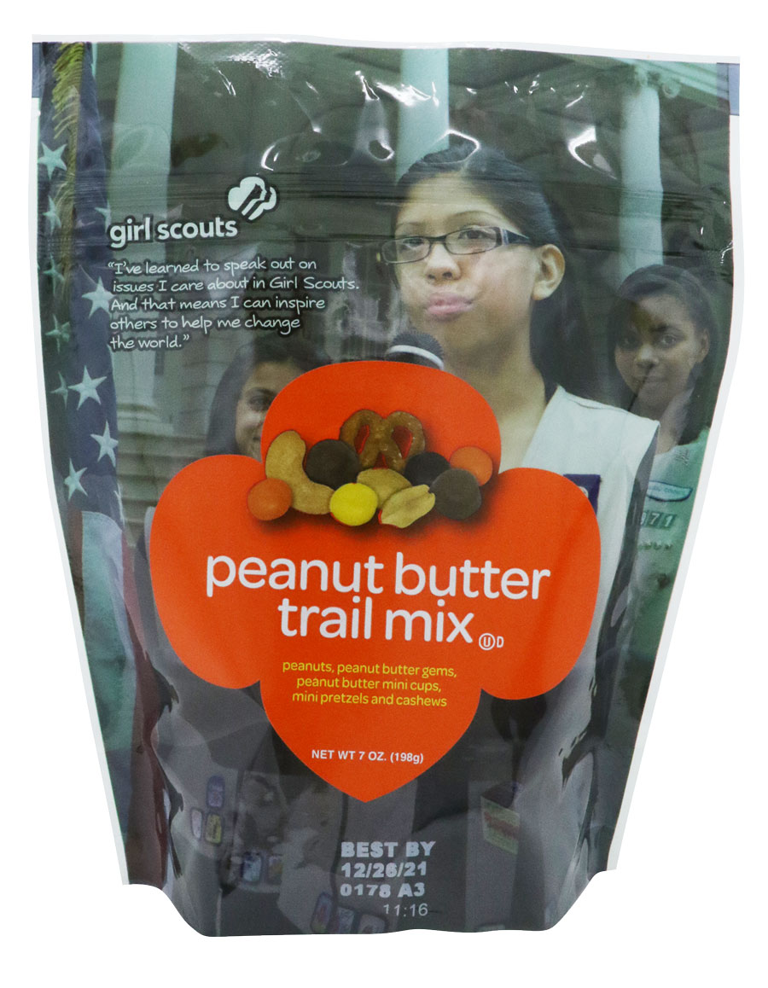
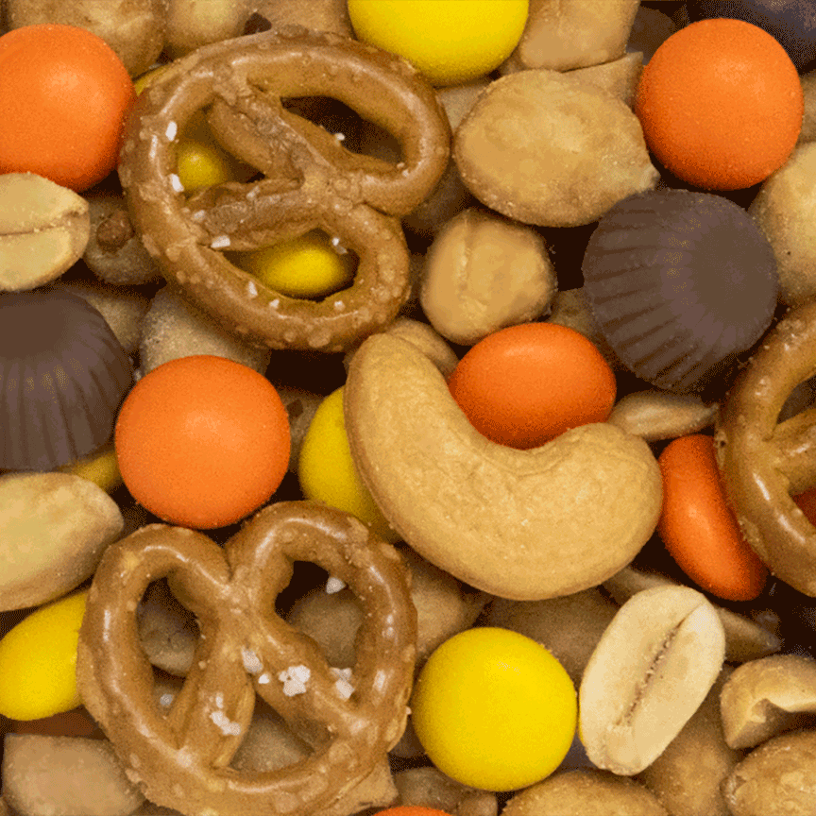
Peanut Butter Trail Mix
$8 Stand Up Bag

Slide 20
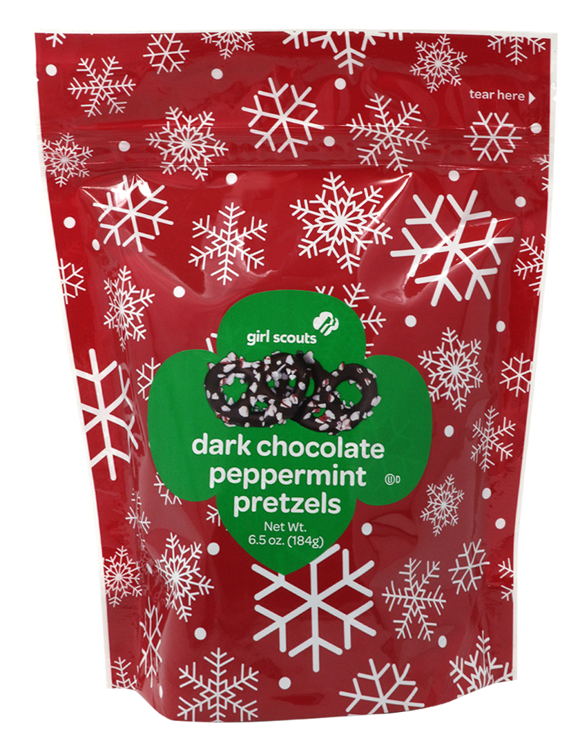
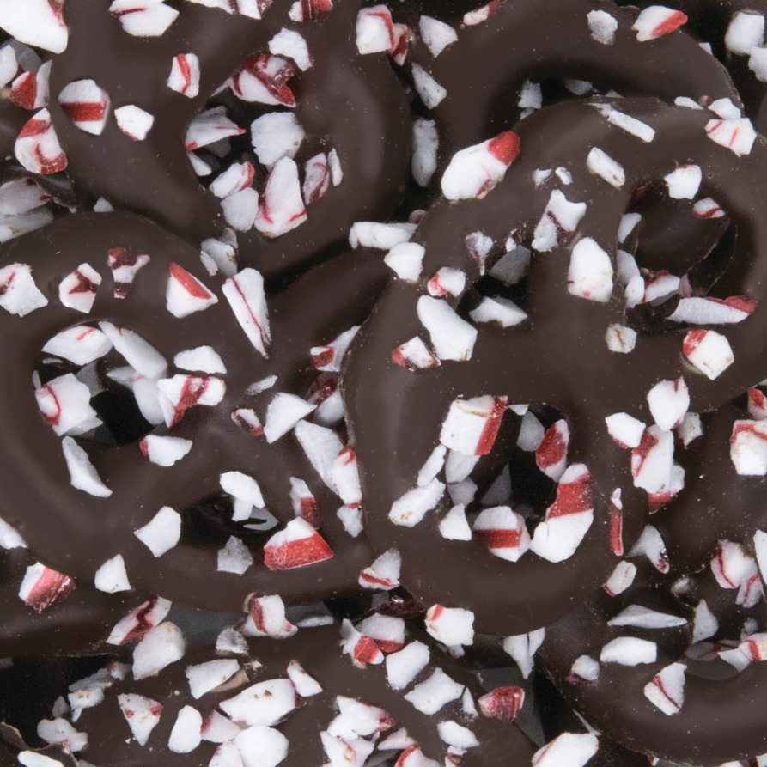
Dark Chocolate Peppermint Pretzels
$7 Stand Up Bag

Slide 21


Dark Chocolate Mint Penguins
$7 Boxed Chocolate

Slide 22


Dark Chocolate Caramel Caps
$7 Boxed Chocolate

Slide 23
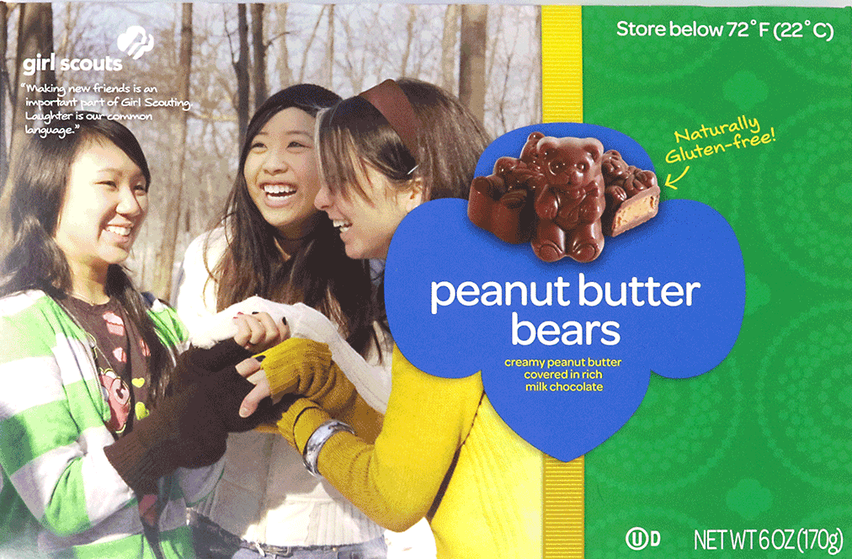
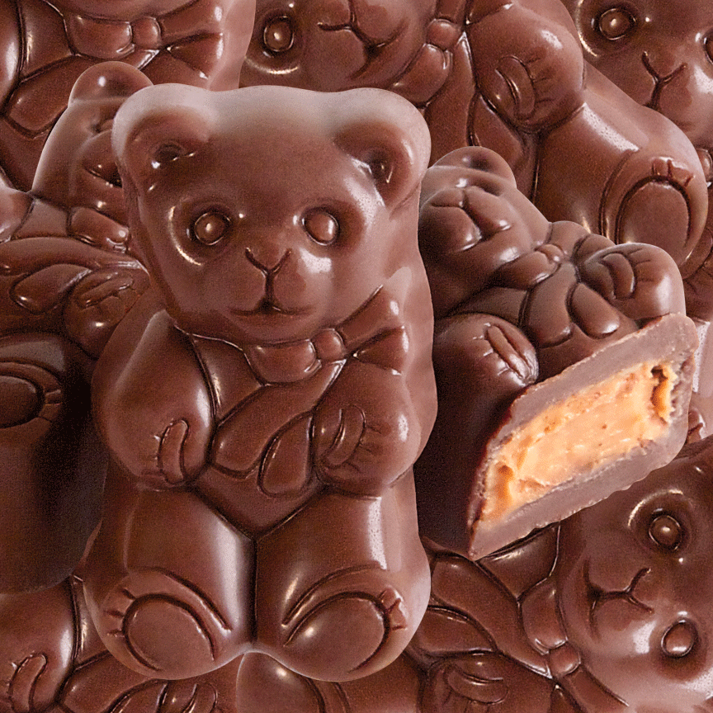
Peanut Butter Bears
$6 Boxed Chocolate

Slide 24
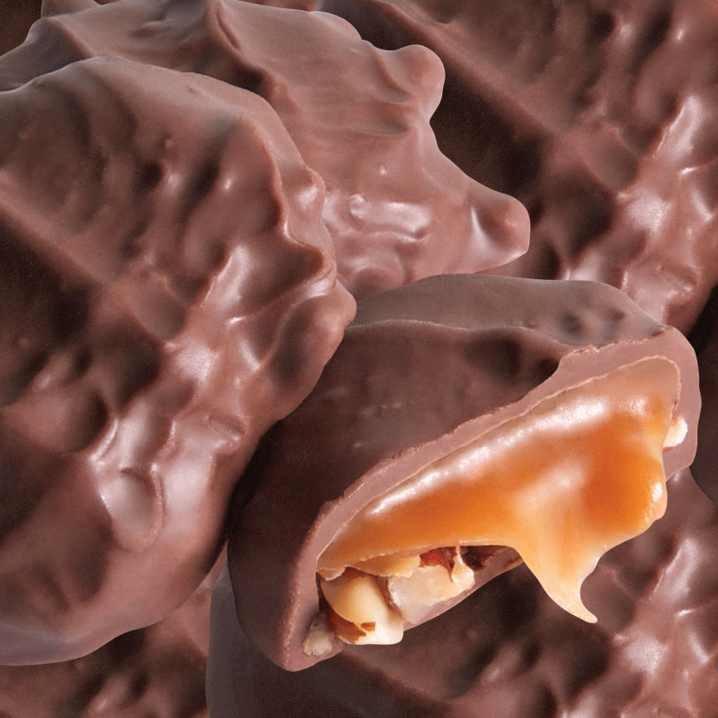

Deluxe Pecan Clusters
$6 Boxed Chocolate

Slide 25
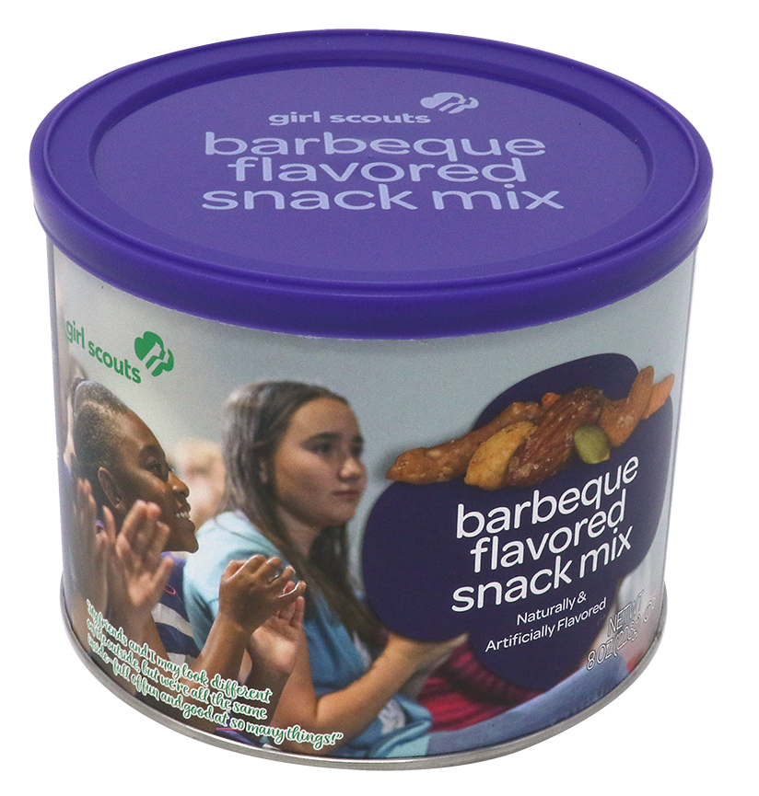
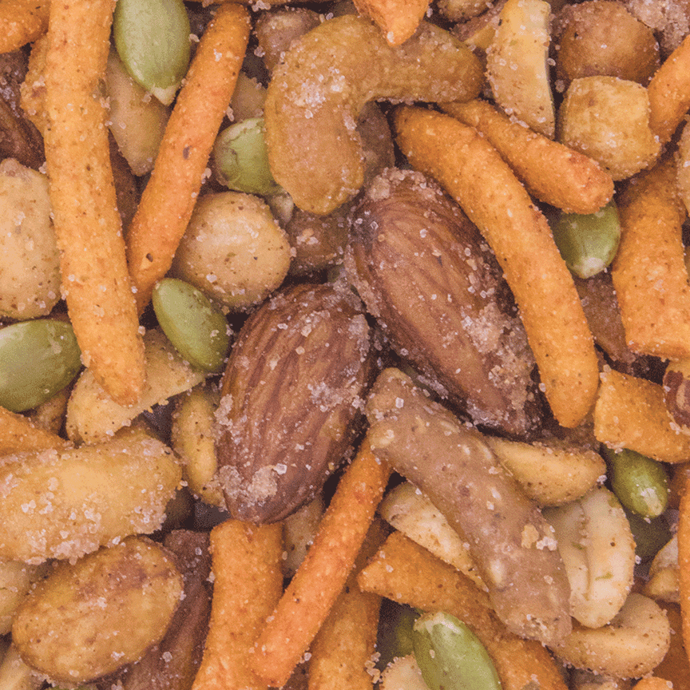
Barbeque Flavored Snack Mix
$6 Pop-top Can

Slide 26


English Butter Toffee
$6 Boxed Chocolate

Slide 27


Dulce de Leche Owls
$6 Boxed Chocolate

Slide 28
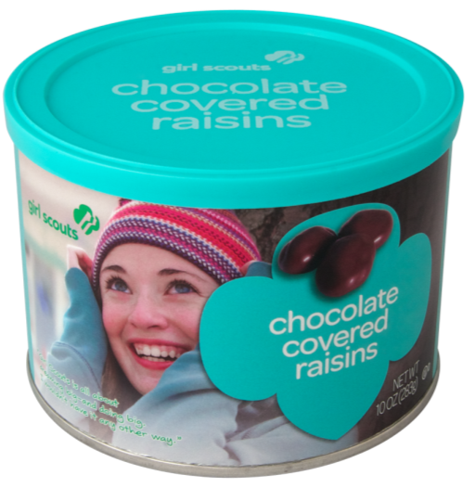
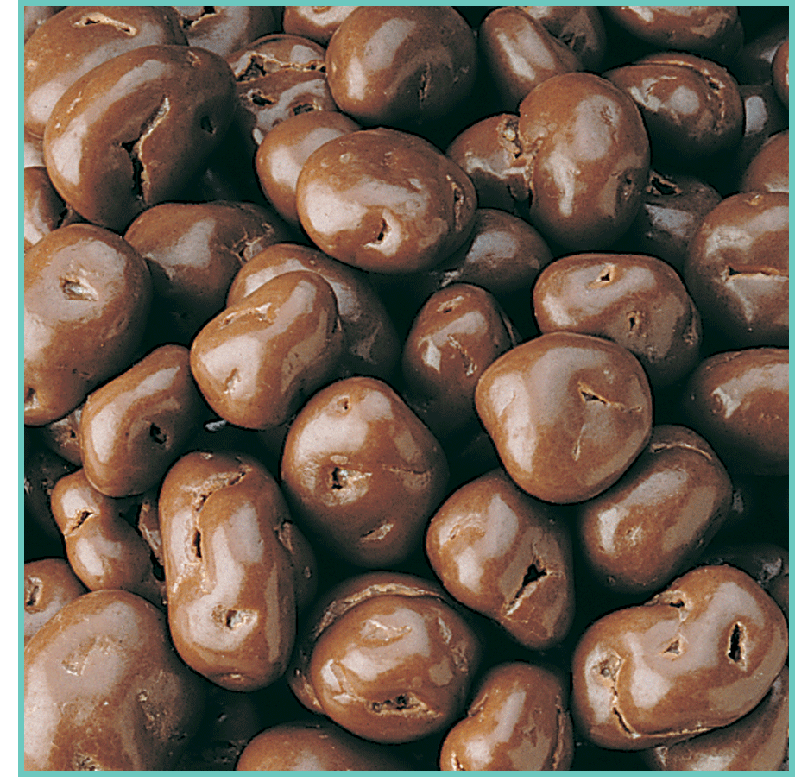
Chocolate Covered Raisins
$6 Pop-top Can

Slide 29
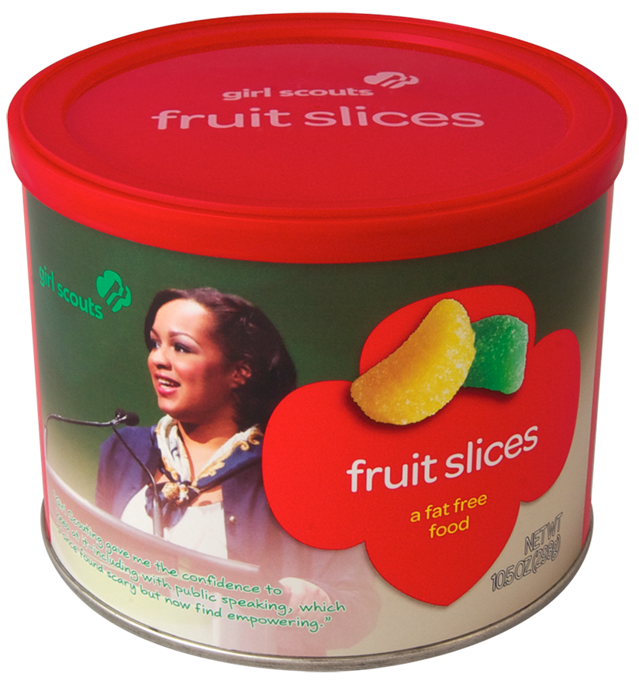
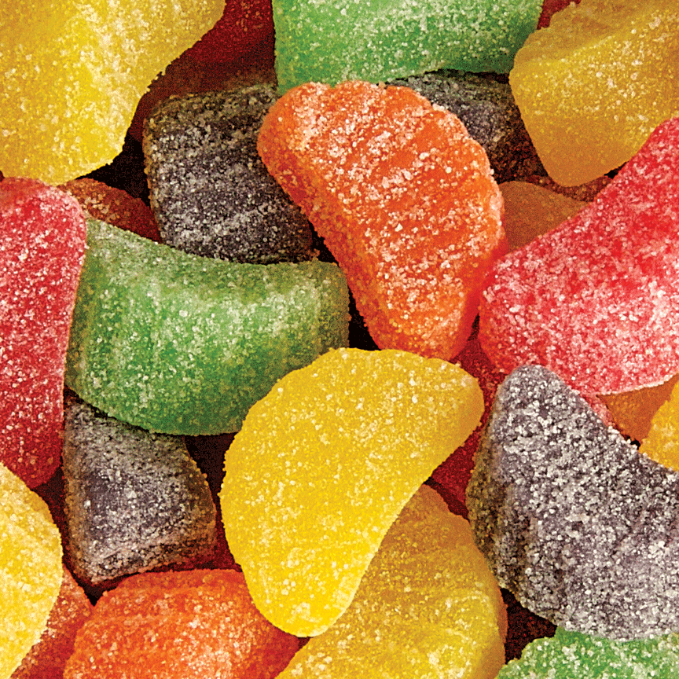
Fruit Slices
$6 Pop Top Can

Slide 30
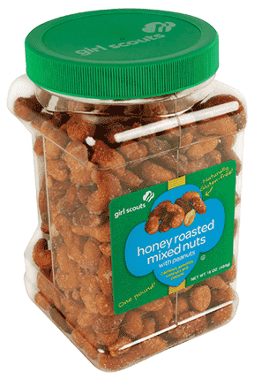
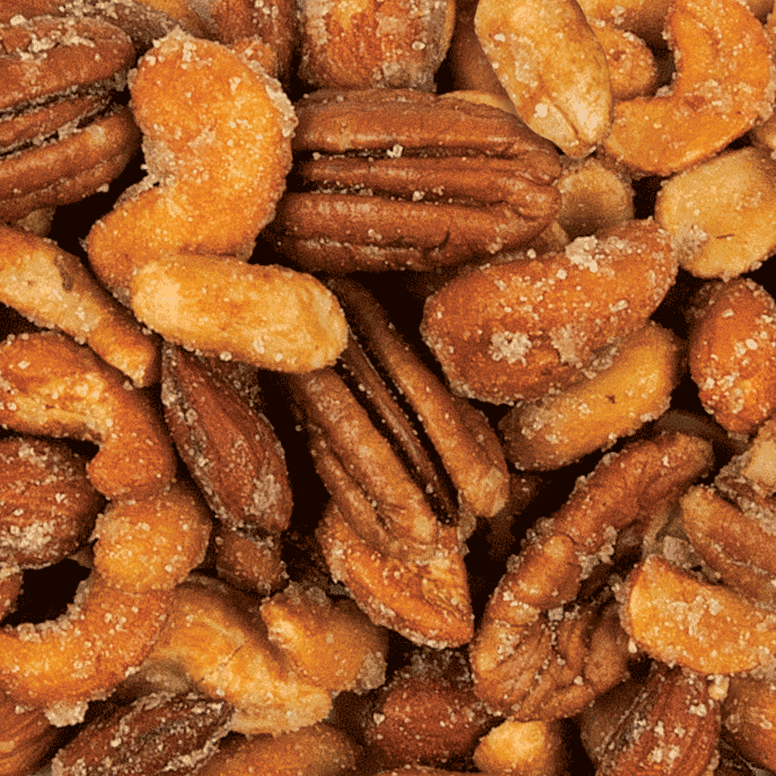
Honey Roasted Mixed Nuts
$10 – 1 Pound Jar

Slide 31

Customers can make $6 donations towards nuts to be donated to Hometown Heroes.
Troops earn proceeds and girls earn credit towards nut recognitions.
Girls earn the Care to Share Patch by selling 3 or more units.

Slide 32

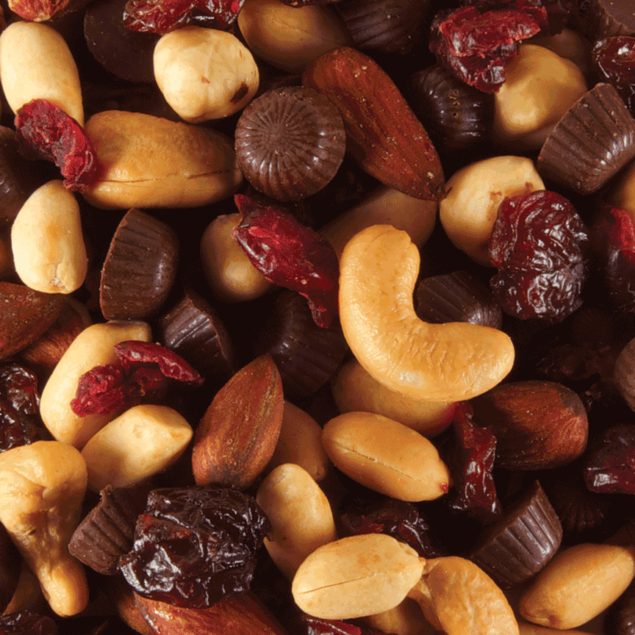
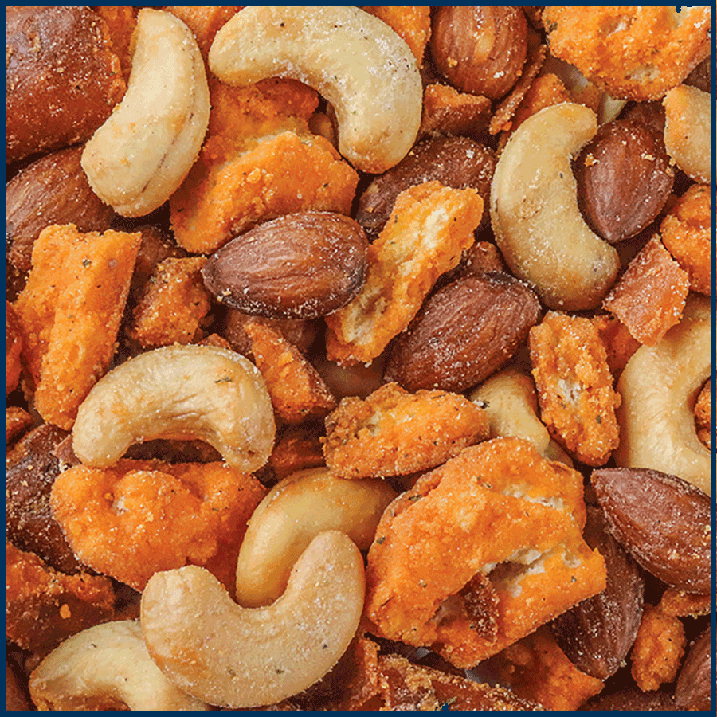
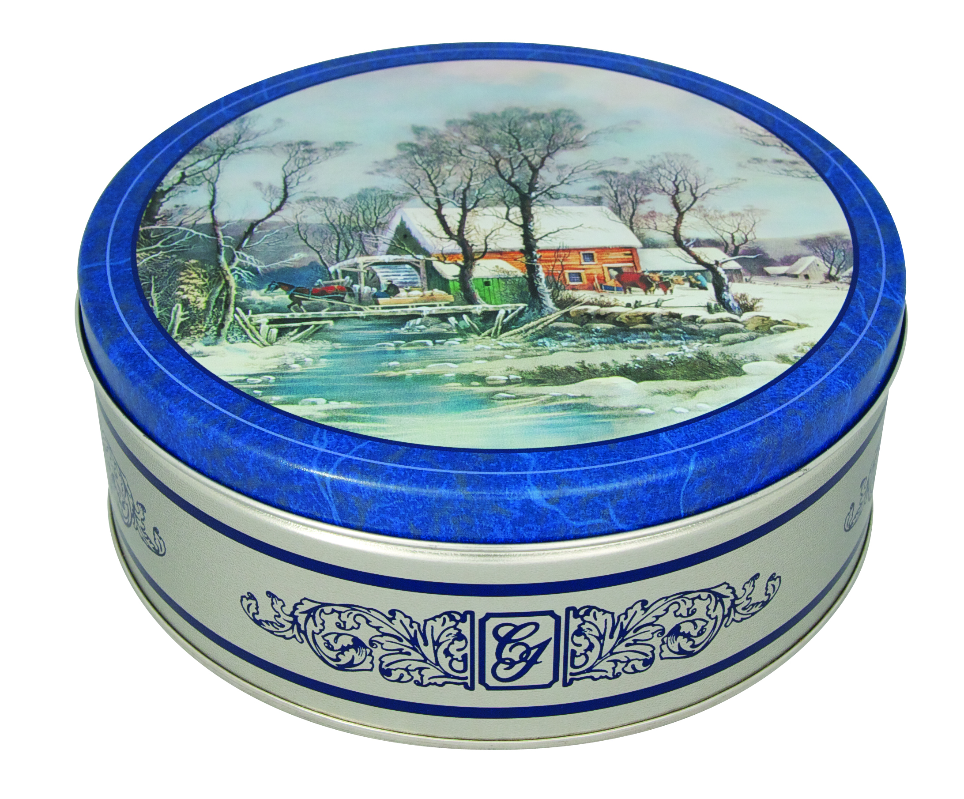
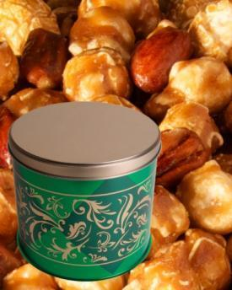
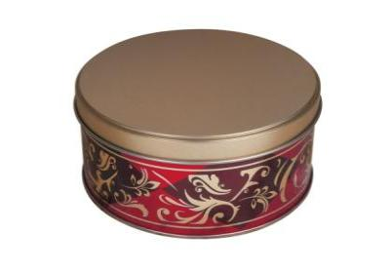

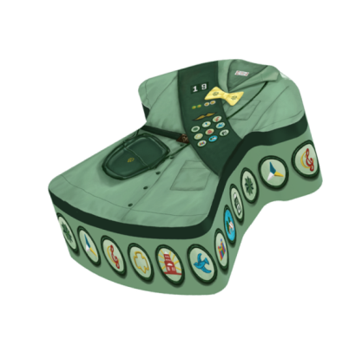
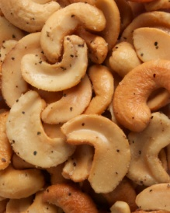
Online Exclusive Items
The online store offers all 25 Girl Scout branded nut/candy items PLUS 9 online exclusive items.
15oz Gourmet Blend
20oz Gourmet Caramel Corn w/ Almonds & Pecans
6oz Almond Cran-Orange Crunch
7oz Black Forrest Trail Mix
7oz Buffalo Ranch Pretzel Mix
15oz Jumbo Cashews
2019 GS Junior Tin w/ Mint Treasures
8oz Salt & Pepper Cashew Halves
6oz Mocha Cups

Slide 33
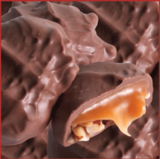
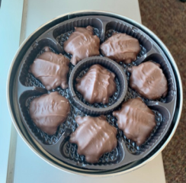
Deluxe Pecan Clusters
$9 Chickadee Tin

Slide 34
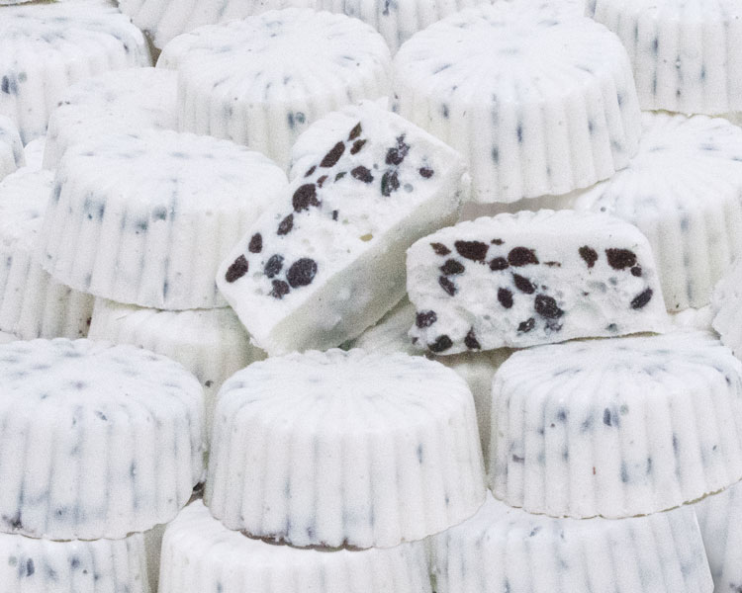
Cookies & Cream Cups
$7 Boxed Chocolate

Slide 35


Online Shipping Chart
Product Subtotal | Standard | 2 Day
$0.01 - $15.00 | $8.95 | $19.60
$15.01 - $30.00 | $10.50 | $25.60
$30.01 - $45.00 | $11.95 | $29.85
$45.01 - $60.00 | $14.50 | $33.00
$60.01 - $75.00 | $20.50 | $38.00
Every additional $15 | + $3.50 | + $7.50

Slide 36











Girl Online Experience
Create a virtual likeness
  Creating avatars makes participating fun and get results with PATENTED Girl Scout platform
Notes:
Zip: 96910

Slide 37


Getting Started
Girls log in as a first-time participant or as a returning user from last year
Spanish experience available

Slide 38
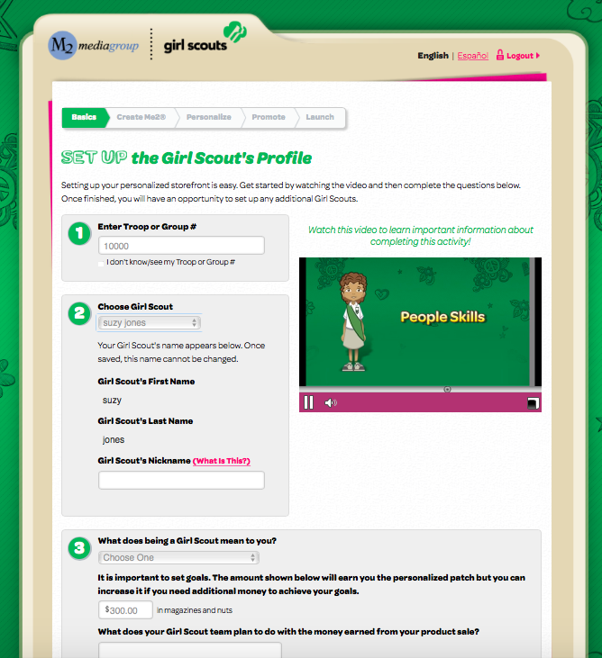
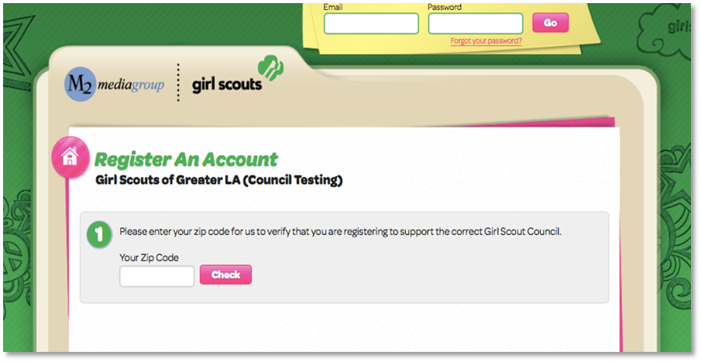
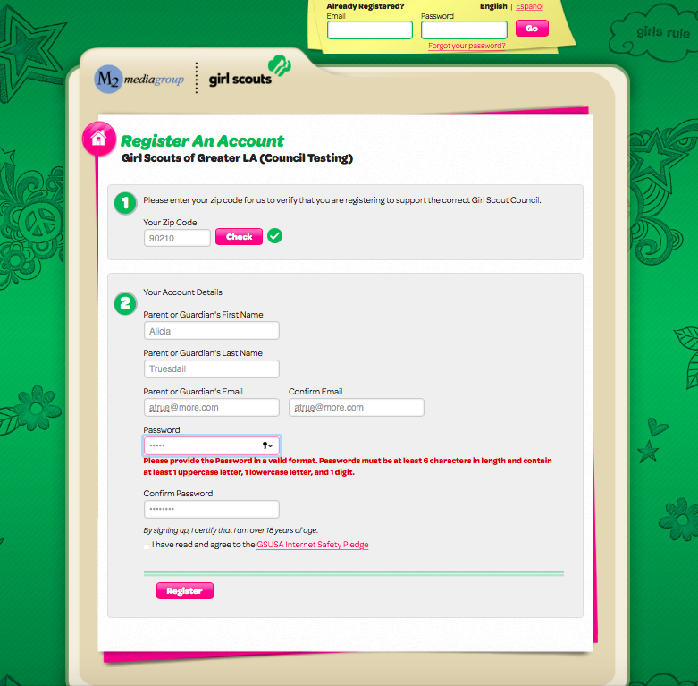
Registering an Account
Zip code validation ensuring girl in correct council
Troop number selection or “I don’t know/see my Troop#/Group#”
Participant can edit nickname
Answer questions about girl goals and what Girl Scouting means to her
Participant information and secure password setup

Slide 39
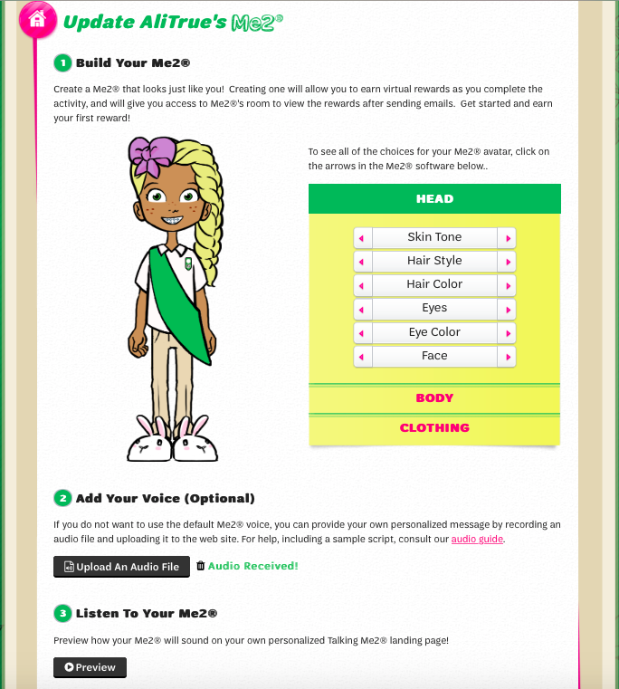

Create Avatar & Record Voice
Avatar
Girl designs her own likeness with over 3 billion avatar feature combinations
New feature choices for
Fall 2020

Slide 40
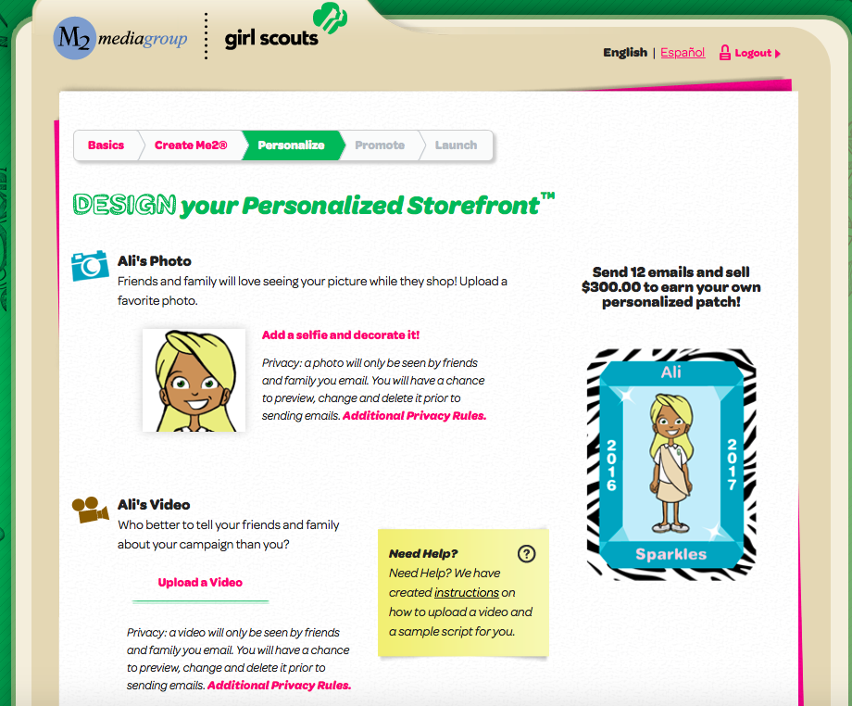

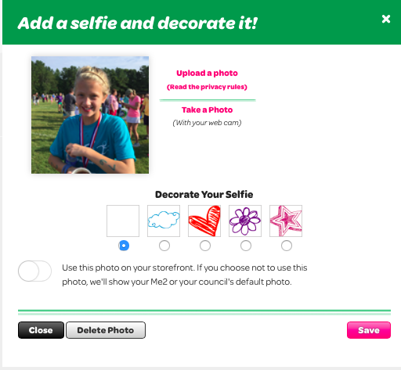
Personalized Campaign
Send 15 emails and sell
Girls can upload a photo or a video which can be shared on their online storefront
  Girls who upload photos and/or videos sell more
  to reach their goals

Slide 41
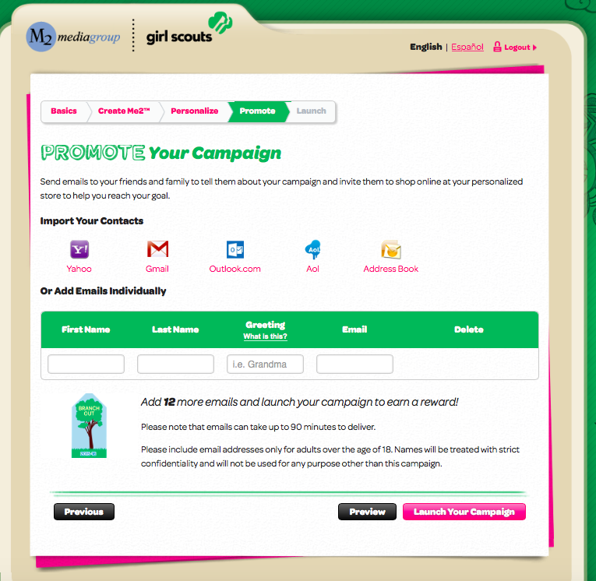
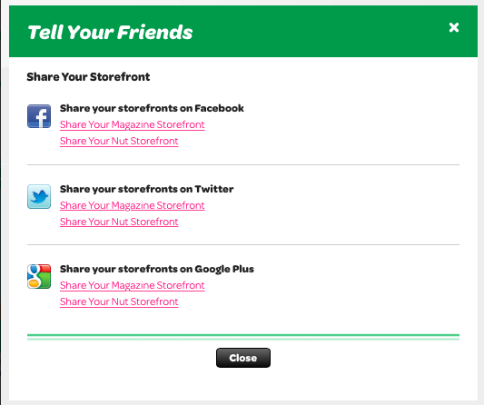
Promoting Her Campaign
Girls share their online storefront link with family and friends by sending emails or sharing on social media
    27% of online sales come from social media
Girls also have business cards preprinted with their storefront code
  Take a picture of the business card and text family and friends.
Easier for returning girls with customer email addresses saved year over year
Option to include last name so friends and family know who is sending the email
Simplicity of one click renewals for customers previously purchasing magazines

Slide 42

Personalized Patch Shipping
Girl chooses name, nickname or initials for her patch
Girl makes selection between two patch backgrounds
Opportunity to provide mailing address after login
Personalized patches ship directly to girls as earned throughout the program

Slide 43



Girl’s Campaign HQ
Navigation tools for all aspects of the program
  Emails/Social Media
  Printable business cards with girl’s online store code
  Manage paper orders (nut card sales entry)
  Rewards earned and actions need to receive rewards
  Reports

Slide 44




Avatar’s Room
Girls can earn virtual rewards for their avatars by completing actions within M2OS
Girls revisit their room an average of 4 times during the program
View virtual rewards earned and troop photo

Slide 45

2020-21 Fall & Girl Scout Cookie Crossover Patch
As a Girl Scout member, girls work to create change and to become dynamic leaders
To earn this crossover patch, girls must:
  Participate in the 2020 Fall Product Program by creating an avatar and sending 15+ emails
  Sell 250+ packages of cookies and send 15+ emails during the 2021 Cookie Program

Slide 46


Customer Emails
Family and friends receive emails with links to shop for magazines and nuts/chocolates and can hear the special message recorded by their favorite Girl Scout

Slide 47


Online Storefronts
Magazine selections include all Time, Inc titles, Reader’s Digest and more!

Slide 48




MAGAZINES
Available to Order online
Pay with credit card
Subscription starts quicker than paper ordering
Great for gift giving!
Reminder: Girls can leave their business cards with customers that they did not email- that unique code allows girls to receive credit!

Slide 49

Online Nuts/Chocolates
Customers have the option to choose girl delivered or direct ship
Customers pay for all products online at the time of checkout

Slide 50


Entering
In-Person Nut Order Card Items
Parents/girls enter the total of each item using the nut order card into the M2OS system prior to the end of the program
Nut order card totals will be tabulated and added to all online sales totals in reports
All in-person nut orders must be entered into M2OS system to be processed

Slide 51

Reports
Reports broken out by sales categories
View all girl delivered items sold online by customer to see which products to deliver
Report emailed to parents at end of program

Slide 52




Volunteer Level Access
Enabling the girl experience
Notes:
Zip: 96910

Slide 53


Welcome to Your Campaign
Prior to Fall Product Program start, volunteers receive email invitation to M2OS
Click link embedded in email to setup password
After login, volunteers can return to council’s M2OS landing page

Slide 54



Getting Started
The Parent/Guardian Email Blast has a 72% open rate - the EASIEST way to get your girls to participate online!
Watch troop training video
Create your troop leader avatar
Within M2OS, launch parent/guardian email blasts announcing troop participation in the Fall Product Program
Manage nut card orders (after girl entry for any girls who didn’t enter their own paper orders)
View reports

Slide 55

Parent and Guardian Email Blast
Troop leaders can launch an email directly to parents with a link and instructions on how to participate
Parent email addresses will be uploaded by council
Volunteers can edit or enter any missing parent/guardian emails

Slide 56

Troop Campaign Headquarters
Headquarters for managing a troop campaign
All program management tools on one site

Slide 57

Messaging Through M2OS
Contacting specific participants, troops and supporters
  Troop to Girl – Announcement, Registered but not Launched, Thank You
  SU to Troop – Everyone, Only those not Logged In, Only those Logged in

Slide 58

Entering In-Person Nut Order Card Items
Select the Girl Scout’s name to edit her orders
Click “+Add Girl Scout” to add orders for any girls missing from the list
Message girls directly with questions about items entered

Slide 59

Girl Rewards
Rewards are automatically calculated for girls
To view rewards, choose the Rewards link from the Troop Dashboard
If girls didn’t make choices, volunteers can make reward selections for them
Detailed reports of earned rewards available under Reports link or through the Delivery Tickets link

Slide 60



Troop Banking & Payments
View troop financial information at a glance including:
  Gross sales
  Total paid online by customers
  Total proceeds earned
  Balance due council
  Girl payments (if entered by troop)

Slide 61


Reports
Click the Reports link from the Troop Dashboard to view total sales or sales by product category
Click a girl name to view the specific details of individual girls
Link on dashboard Troop Summary/Amount Due Report

Slide 62

Service Unit Dashboard
Send messages to troops
Manage troop admin users
Manage/edit girl and troop products
View troop financials and payments made to council
Troop sales summaries
Delivery tickets

Slide 63

Delivery Tickets
Print delivery tickets by SU, troop or girl
Available for products and rewards for easier picking and packing
Option to include financials

Slide 64

Volunteer
Avatar
Patch
Troop Fall Product Chairs
Earned by achieving $700 in total Troop sales

Slide 65
What’s Next?
Remind troops to login to M2OS, watch training video and create their avatar
Encourage troops to send the Parent/Guardian launch email to participants
  Girls setup their own campaign on M2OS, so troop leaders don’t need to
Emphasize the simplicity of online girl delivered items
  Money collected online and items automatically added for the girls
  Girl simply deliver the items

Slide 66
Important Dates
Volunteers will receive login emails on September 22nd
Program begins: October 2nd
In-person girl order taking and girl delivered online order taking ends: October 25th
Last day for parents to enter paper orders in M2OS: October 26th
Last day for troops to enter orders in M2OS for girls: October 28th
SU lockout: October 28th
Online orders for Direct Ship Nuts and Magazines ends: October 25th
SU Nut Deliveries: November 16th

Slide 67

Fall Product Program
Customer Care
M2’s Customer Care team is cross-trained to handle tech support, volunteer/participant and customer inquiries
100% customer satisfaction guarantee

Slide 68


Thank you!
You are the difference!
Thank you for contributing to the positive experiences girls have through the Fall Product Program
We appreciate you and all that you do to support Girl Scouts!

